Slide 1

University of Houston
Property Management Guidelines
Annual Training for Departmental Property Custodians

Slide 2
Objectives
  Policies and Procedures
  Why is Property Management Important?
  Roles and Responsibilities of Agency Head, University Property Manager, and Department Property Custodian
  Definition of Assets & Thresholds (property) types – Capital vs. Controlled
  Expenditure Account Codes for Some Capital Assets
  Acquisition
  Federally Purchased Equipment
  Identification and Tagging of Assets
  Tagging Assets
  Dispositions of assets – Donations, Transfers, Trade-ins, Salvage, Obsolete, Lost, Missing, Stolen
  Surplus Warehouse Asset Transfers
  Annual Physical Inventory Verification – Key Elements
  Departmental Audit
  Asset By Department Report
  PeopleSoft Asset Management System (PSAM) How to use as a Resource
  Property Management Forms (Updated effective 09/01/2022)
  Contact Information

Slide 3
Policies and Procedures
Texas Administrative Code 34 Chapter 5 §5.200
State Property Accounting
SAM 03.E.02, Property Management
MAPP 03.03.01, Property Management
Property Management Guidelines
Forms
AIM Work Order Request (Fixit)

Slide 4

Why is Property Management Important?
Ensures State funded University assets are accounted for and properly maintained
Provides compliance with Federal and State guidelines
Accurate and timely records provides good audit results
Prevents reduction in appropriations
Maximizes the use of Resources
Provides accurate and insurable values
Identifies saleable/surplus assets
Provides lowest inventory investment
Proper stewardship of assets and supplies
Accurate and timely reconciliations and reporting

Slide 5
Roles and Responsibilities
Agency Head
The agency head ensures that the University maintains adequate internal controls and complies with asset management policies and procedures.
Each agency head must designate a property manager by completing form 73-286 Notice of Agency Head and Designation of Property Manager form.
  This form is available on the Texas Comptroller’s website.
Property Manager
The property manager is the custodian of all property in the possession of the University.
The property manager is responsible for maintaining the required records of physical inventory.
Property Managers have update capabilities for all assets in the PSAM system.
Maintain copies of policies and procedures, guidelines and other appropriate documentation for managing the University’s property in accordance with the Texas State Comptroller’s office.
Ensure that the procedures for accountability and safeguarding of the University’s property comply with the Comptroller’s requirements.

Slide 6
Roles and Responsibilities – (continued)
Department/College Business Administrator
The Department/College Business Administrator ensures correct expenditure accounts are used to record capital and controlled assets.
Submit appropriate forms to add or change the Department Property Custodian.
Employees
Employees are required to use university property only for the stated purpose and to exercise reasonable care for the properties safekeeping.
Submit the Authorization Off-Campus Property form prior to taking any university property off-campus.
Financially responsible in the event of loss, destruction or damage if the loss or damage results from negligence, intentional act or failure to exercise reasonable care to safeguard.

Slide 7
Roles and Responsibilities – (continued)
Department Property Custodian
The Department Property Custodian ensures compliance with the inventory control procedures and safekeeping of capital and controlled assets.
Reports capital and controlled assets received (by means other than purchase) to Property Management in a timely manner via the Asset Update Form.
Ensures property is not loaned, traded, discarded, moved or cannibalized without prior approval from Property Management.
Reports defaced or damaged property to Property Management in a timely manner via Asset Update Form.
Ensures property is not returned to a vendor as a trade-in without the approval of Property Management.
Provide appropriate documentation on obsolete and excess property (capital and/or controlled only) to Property Management for approval to dispose.
Ensures equipment is used for its intended purpose by properly trained personnel
Responsible for ensuring inventory which meets the appropriate threshold is tagged within the Department/College and listed on the Departmental Inventory of Physical Property.
Document all items located off-campus by completing the Authorization Off-Campus Property Form.

Slide 8
Definition of Assets & Thresholds
Capital Assets - Real or Personal Property that has an estimated life of greater than one year with a value equal to or greater than capital threshold established for the asset type.
  Real Property - Land, Building, Infrastructure, Construction in Progress.
  Personal Property - Furniture & Equipment, Vehicles, Boats, Aircraft, Library Books & Materials, Works of Art, Computer Software, intangible assets, etc.)
Class of Asset | Threshold | Expenditure Account Code | Class of Asset | Threshold | Expenditure Account Code
Tangible Assets |  |  | Intangible Assets
Land and land improvements | $0 | 58XXX | Land use rights – permanent life | $0 | 58XXX
Construction in progress | $0 |  | Land use rights – term life | $100,000
Buildings and building improvements | $100,000 |  | Computer software | $100,000 | 58611
Facilities and other improvements | $100,000 |  | Internally developed computer software | $1,000,000 | 58611
Infrastructure, depreciable | $500,000 |  | Other intangible capital assets | $100,000 | 58910 - 58911
Infrastructure, non-depreciable | $0
Furniture and equipment | $10,000 | 58601 - 58603
Vehicles, boats and aircraft | $10,000 | 58600 - 58616
Other capital assets |  | 58900 - 58904
Library books/materials (collections) | $0
Works of art and historical treasures | $0 | 58XXX
Leasehold improvements | $100,000
Livestock | $5,000
Notes:
Personal Property Note: Assets that have sufficient value to warrant inclusion in the fixed asset portion of the financial statement. due to their high risk nature and with a value less than their capital threshold, are required to have management controls placed upon them and reported to the State comptroller’s office. Does not include consumable items.

Slide 9
Definition of Assets & Thresholds– (continued)
State Controlled Asset –Personal Property due to its high-risk nature, and with a value, less than capital threshold.
State Controlled Asset Class | Threshold | Expenditure Account
Handguns, Rifles, Shotguns | $0 | 54354
Sound Systems, Portable Cameras, Television, Video Players, Recorders, | $500 to $9,999.99 | 54354
Computers, Laptops, Data Projectors, Smartphones, Tablets, iPads, Unmanned Aerial Vehicle (UAV) Drones | $500 to $9,999.99 | 54355
Notes:
Personal Property Note: Assets that have sufficient value to warrant inclusion in the fixed asset portion of the financial statement. due to their high risk nature and with a value less than their capital threshold, are required to have management controls placed upon them and reported to the State comptroller’s office. Does not include consumable items.

Slide 10
Definitions of Assets (continued)
Cannibalization – the authorized removal of components from one item of property for installation on another item of property to meet a specific requirement and/or to return an item to service.
Fabrication – Using component parts to build a piece of equipment, where in the value of the equipment built meets or exceeds the capitalization threshold of $10,000
Federal Property – Items that are furnished to the University by the Federal Government or are acquired through a Federal contract or grant. Title to this property remains with the Federal Government unless it is expressly vested with the University or until the University fulfills contractual terms with permit title transfer.
Surplus/Salvage Property – Property through use, time, or accident becomes depleted, worn out, damaged or obsolete and can no longer serve the purpose for which it was initially intended. Surplus property may be cannibalized with appropriate documentation.

Slide 11
Acquisition
Property may be acquired by
  Purchase (state, local, or federal sources)
  Construction of property
  Gifts or Donations
  Debt financed instruments (capital leases, operating leases, bonds)
  Transfers from a state agency
  Transfers from an external university, etc.
Donations Inbound - Must be approved in advance by University Advancement Office, and Property Management via Asset Update Form.
Federal Loaned Equipment – Sponsored program, academic or research, must be approved by Division of Research. Use Asset Update Form and submit to Property Management

Slide 12
Federally Purchased Equipment
Federally purchased equipment is equipment purchased with federal funds, including pass-through to the University. Equipment can be Federally Titled or Conditionally Titled with the University.
  Federally titled equipment (government property) is equipment furnished to the university by the federal government, or equipment acquired or fabricated using funds from a federal sponsored project or contract where the agreement specifies that the title to the equipment remains with the government.
  Conditionally Titled equipment is equipment that was purchased on federally sponsored projects where the title conditionally vests with the University.
  In general, sponsored projects identify the title to equipment in the terms of the agreement while sponsored contracts retain federal ownership for all equipment with a cost of over $10,000.

Slide 13
Federally Purchased Equipment (continued)
If property is funded by a Federal Grant, or furnished to the University by the Federal Government the property tag number will begin with a “G”. Specific information about these assets are maintained in the Property Management inventory record.
  The capital threshold for federally titled assets are $5,000.
  Departments with such property are required to:
      Conducting annual inventory.
      Ensuring that equipment is properly maintained and used for award purposes until the award ends or the equipment is no longer needed.
      Ensuring that equipment purchased with federal funds is made available for use on other federally funded programs.
      Obtain Division of Research and Property Management’s approval for all assets transferred or disposed. The Grant may stipulate unique disposal actions.
      Notify Property Management of impaired assets that require a change in condition from “good” to “fair” or “poor”.
      This rule is effective for Grants Awarded after 12/26/2014.

Slide 14
Identification and Tagging
Property Tagging
  Why – Ownership identification
  What – Capital and Controlled assets
  How – Barcode tags
  Who – Department Property Custodian and/or Property Management Only
  Where –Visible to all
  Key Elements –Property assigned to a department; Physical Location (Obtained from Requisition/Purchase order/voucher or manual update via Asset Tagging Form)
  Federal Property requires a separate barcode tag that begins with ‘G’

Slide 15
Tagging Assets
Property Management will generate tags for Department assets
A property tag (paper tag printed with name of the institution, a barcode and 6-digit number) must be affixed to all tangible items that are – Capital assets with a cost of $10,000 and greater and Controlled assets with a cost between $500-$9,999.99.
Capital and controlled assets purchased with federal funds, or items that are furnished to the university by the federal government, after December 2014 are tagged with a barcode and a seven-digit tag that is alpha-numeric begins with the letter G.
This is to identify the asset as federally sourced for compliance with the new A-81 regulations.
Property Management personnel will work with departmental property custodians to help ensure tags are affixed to purchased property.
Capital property of fixed assets received as donations or gifts are also marked with the standard University of Houston property tag. Contact Property Management for guidance on these items.

Slide 16
Tagging Dell Assets
Certain items purchased from Dell are delivered to the University with a tag already affixed.
Property Management receives a Daily Asset Report from Dell which provides a listing of tagged assets.
Property Management reviews and analyzes the capital and controlled assets to update the Asset Management system.

Slide 17
Disposition of Assets
Most commonly used disposition methods at UH are:
  Surplus Property - Surplus property is any personal property that is in excess of the needs of the Department/College. Surplus property may be new, used or salvage.
  Donations - Only to Independent School Districts or other State Institutions. Must be coordinated through Property Management. Receiving agency must request (on their letterhead) the specific property in advance of the donation. Departmental approvals are required.
  Trade-in -one property is acquired by the exchange of another property. A Department/College may offer surplus or salvage property as a trade-in on new property of the same general type if the exchange is in the best interest of the university. Prior approval from Property Management is required via the Asset Update Form.
  Inter-Agency Transfers – Transfer of property to another state agency. Department/College must inform Property Management prior to transfer of the property via the Asset Update Form.
  Obsolete/Salvage - Property which through use, time or accident becomes depleted, worn out, damaged and can no longer serve the purpose for which it was originally intended. Salvage property can be cannibalized or sent to Property Management for disposal.
  Cannibalization – Parts may be cannibalized from one asset to another to return to service. Prior approval from Property management is required via Asset Update Form.
  Missing, Damaged, or Stolen – Property lost, missing, or stolen must be reported to Property Management immediately with appropriate documentation. Failure to properly track and report missing property would represent negligence or fraud.
Note: Federal equipment with ‘G’ tags shall not be cannibalized or disposed without approval from Division of Research and Property Management.

Slide 18
Surplus Warehouse Asset Transfers
To transfer assets to the Surplus Warehouse
  The department will complete the forms listed below, providing information on the assets to be transferred, the cost center to be used for the work order, and contact information.
    Form PRP-1A, Asset Update Form
    Form PRP- 1A (section B), if data processing equipment is being transferred
    Surplus Transfer Property List
    Lab Equipment Safety Form (if required)
  If lab equipment or other potentially hazardous material is being requested to be transferred to the Surplus Warehouse, Environmental Health and Safety’s (EHS) approval is required on the Lab Equipment Safety Form. Potentially hazardous items cannot be transferred without the approval of EHS.
  Property Management requests a work order for moving services and submits to the Facilities Service Center.

Slide 19
Annual Physical Inventory
The University is required to conduct an annual physical inventory of the trust, capitalized and controlled personal property (excluding libraries and historical arts and treasurers) that is in the University’s possession at a time its own choosing.
Annual inventory time frames and due dates will be made available by publication on the Property Management website and emails to the College/Division Administrators and Property Custodians.
All departments are required to conduct annual inventory using a scanner
  60 scanners are available to be reserved and checked out.
  To reserve a scanner email at ajhutch3@Central.uh.edu by providing the following information:
      Your name
      The Department ID(s) of the inventory to be scanned
      The email address to send the scan results
      The date you would like to pick up the scanner
      Scanners can be picked up after 8:00 AM on Mondays
      Scanners are due by 5:00 PM on Friday of the same week
      Scanner batteries will last for approximately five days if the scanner is turned off when not in use

Slide 20
Annual Physical Inventory (continued)
Each department will receive a department inventory listing with instructions on how to conduct the annual inventory when a scanner is checked out.
The department inventory listing provides the following information:
    University Inventory Tag Number
    Asset Class
    Acquisition Date
    Description of the asset
    Location (department, building, and room number)
    Serial number, (when applicable)
    Historical cost of the asset
The scanners verify the
    University Tag Number
    Location: Building; Floor; Room; Suite
    Off-Campus – Possession of the property verified with Off-campus Asset form

Slide 21
Annual Physical Inventory (continued)
After Department Inventory is completed with scanning
  The scanner is returned, Property Management extracts the scanned inventory report from the scanner. Scanned inventory files are uploaded to PeopleSoft Asset Management, Property Management personnel generate an inventory report for the Department. The inventory reports are emailed to the department Property Custodian for review and updates.
  After the final scanned inventory is completed and all related forms are received (Missing/Stolen, Transfer, updated Off-Campus Equipment forms), Property Management will send the department the final Property Listing.
  Departments submit the CERTIFICATION OF DEPARTMENTAL PHYSICAL INVENTORY Form via DocuSign.
      This form requires the signature of the Property Custodian, the Department Head, and College/Division Business Administrator.
      This form is due to Property Management within 30 days of the Annual Inventory due date.
  .

Slide 22
Departmental Audit
Annually, after all inventories are complete, 15 departments are randomly selected for inventory verification audits.
Property Management contacts the selected departments to schedule the verification visit.
Inventory audit verification includes confirming the location and existence of a sample of departmental assets to the most recently submitted inventory report.
For a detailing of Annual Physical Inventory processes, refer to UH Property Management Guidelines at:
    Property Management Guidelines - University of Houston (uh.edu)

Slide 23
Asset By Department Report
Departments can run an Asset By Department Report in PeopleSoft.
  The report provides a list of the current assets assigned to the department.
  The cost center of the asset
The Asset By Department Report is ran in PeopleSoft Finance by selecting the following:
  Main Menu>Custom Reports>AM>Asset By Department

Slide 24
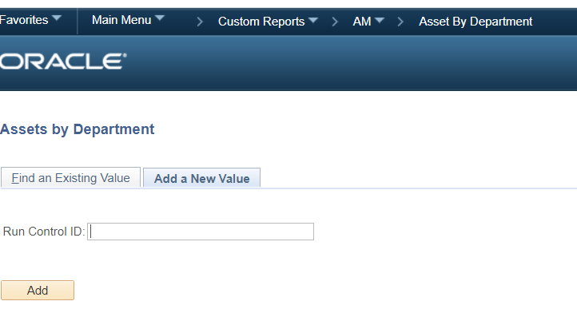
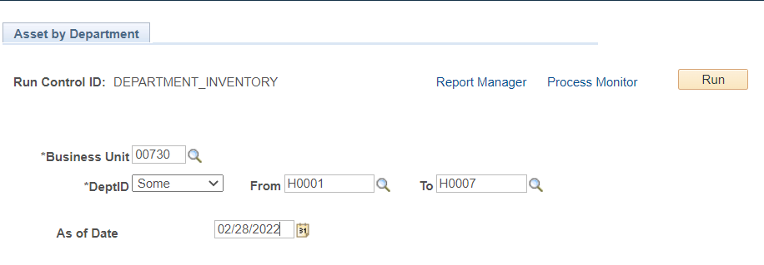
PeopleSoft Asset Management System (PSAM) – How to run Asset By Department Report
* You can RUN as PDF and/or CSV (Excel) files

Slide 25
Property Management Forms
Property Management forms were revised effective 9/1/2022
and are processed through DocuSign
During the Year
  Asset Update Form – PRP-1A
  Off Campus Property Returned Form
  Departmental Property Custodian – PRP-6 (Change of Departmental Property Custodian)
  Certification of Departmental Physical Inventory
Annually (Beginning of Fiscal Year)
  Departmental Property Custodian – PRP-6
  Authorization Off-Campus Property – PRP-2
Forms are located on the Property Management website

Slide 26

Property Management Contacts
Property Management Email: Propertyacctg@UH.EDU
Minhthu Pham – Senior Property Manager
Phone: 713-743-8757
Email: Mpham@Central.UH.EDU
Victor Wongchukit – Assistant Property Manager
Phone: 713-743-8758
Email: Vwongchukit@Central.UH.EDU
Langston Royster – Accountant II
Phone: 713-743-8760
Email: LFRoyster@Central.UH.EDU
Raymon Matthews – Coordinator
Phone: 713-743-8759
Email: Rmatthews@Central.UH.EDU
Amy Hutchings – Accountant II
Phone: 713-743-7766
Email: ajhutch3@UH.EDU.

Slide 27
Conclusion
Thank you for completing the Property Custodian Training. It’s now time to take the quiz.

