Slide 1

University of Houston
Property Management Guidelines
September 12, 2022

Slide 2
Objectives
  Policies and Procedures
  Why is Property Management Important?
  Roles and Responsibilities
  Definition of Assets & Thresholds (property) types – Capital vs. Controlled
  Expenditure Account Codes for Some Capital Assets
  Acquisition, Identification and Tagging of assets
  Dispositions of assets – Donations, Transfers, Trade-ins, Salvage, Obsolete, Lost, Missing, Stolen
  Annual Physical Inventory Verification
  PeopleSoft Asset Management System (PSAM) How to use as a Resource
  Property Management Forms (Updated effective 09/01/2022)
  Contact Information
  Q & A

Slide 3
Policies and Procedures
Texas Administrative Code 34 Chapter 5 §5.200
  https://texreg.sos.state.tx.us/public/readtac$ext.TacPage?sl=R&app=9&p_dir=&p_rloc=&p_tloc=&p_ploc=&pg=1&p_tac=&ti=34&pt=1&ch=5&rl=200
State Property Accounting
  https://fmx.cpa.texas.gov/fmx/spa/
SAM 03.E.02, Property Management
  https://uhsystem.edu/compliance-ethics/_docs/sam/03/3e2.pdf
MAPP 03.03.01, Property Management
  https://uh.edu/policies/_docs/mapp/03/030301.pdf
UH Main Campus Property Management Guidelines (Work-in-Progress)
  https://uh.edu/office-of-finance/accounting-services/property-management/guidelines/
Forms Hyperlink
  https://uh.edu/office-of-finance/accounting-services/property-management/forms/
AIM Work Order Request (Fixit)
  https://uhready.assetworks.cloud/ready/

Slide 4

Why is Property Management Important?
State funded institution assets accounted for and properly maintained
Be in compliance with Federal and State guidelines
Accurate and timely records gives good audit results
No reduction in appropriations
Maximizes use of Resources
Provides accurate insurable values
Identify saleable/surplus assets
Provide lowest inventory investment
Proper stewardship of assets and supplies
Accurate and timely reconciliation and reporting

Slide 5
Definition of Assets & Thresholds
Capital Assets - Real or Personal Property that has an estimated life of greater than one year with a value equal to or greater than capital threshold established for the asset type.
  Real Property - Land, Building, Infrastructure, Construction in Progress.
  Personal Property - Furniture & Equipment, Vehicles, Boats, Aircraft, Library Books & Materials, Works of Art, Computer Software, intangible assets, etc.)
Class of Asset | Threshold | Expenditure Account Code | Class of Asset | Threshold | Expenditure Account Code
Tangible Assets |  |  | Intangible Assets
Land and land improvements | $0 | 58XXX | Land use rights – permanent life | $0 | 58XXX
Construction in progress | $0 |  | Land use rights – term life | $100,000
Buildings and building improvements | $100,000 |  | Computer software | $100,000 | 58611
Facilities and other improvements | $100,000 |  | Internally developed computer software | $1,000,000 | 58611
Infrastructure, depreciable | $500,000 |  | Other intangible capital assets | $100,000 | 58910 - 58911
Infrastructure, non-depreciable | $0
Furniture and equipment | $10,000 | 58601 - 58603
Vehicles, boats and aircraft | $10,000 | 58600 - 58616
Other capital assets |  | 58900 - 58904
Library books/materials (collections) | $0
Works of art and historical treasures | $0 | 58XXX
Leasehold improvements | $100,000
Livestock | $5,000
Notes:
Personal Property Note: Assets that have sufficient value to warrant inclusion in the fixed asset portion of the financial statement. due to their high risk nature and with a value less than their capital threshold, are required to have management controls placed upon them and reported to the State comptroller’s office. Does not include consumable items.

Slide 6
Definition of Assets & Thresholds– (continued)
State Controlled Asset –Personal Property due to its high-risk nature, and with a value, less than capital threshold.
State Controlled Asset Class | Threshold | Expenditure Account
Handguns, Rifles, Shotguns | $0 | 54354
Sound Systems, Portable Cameras, Television, Video Players, Recorders, | $500 to $9,999.99 | 54354
Computers, Laptops, Data Projectors, Smartphones, Tablets, Ipads, Unmanned Aerial Vehicle (UAV) Drones | $500 to $9,999.99 | 54355
Notes:
Personal Property Note: Assets that have sufficient value to warrant inclusion in the fixed asset portion of the financial statement. due to their high risk nature and with a value less than their capital threshold, are required to have management controls placed upon them and reported to the State comptroller’s office. Does not include consumable items.

Slide 7
Roles and Responsibilities
Agency Head
The agency head should ensure that the agency maintains adequate internal control procedures.
Each agency head must designate a property manager.
Complete the Notice of Agency Head and Designation of Property Manager. form (73-286) to inform the Comptroller’s office of the designee
Property Manager
The custodian of all property in the possession of the institution/agency.
Responsible for maintaining the required records of physical inventory.
Have update capabilities for all assets in PSAM system.
Must maintain copies of the rules, procedures and other appropriate documentation for managing the institution’s/agency’s property as formulated by the Comptroller’s office.
Ensure that the procedures for accountability and safeguarding of the agency’s property comply with Comptroller’s office rules and requirements.

Slide 8
Roles and Responsibilities – (continued)
Department Property Custodian
Ensure compliance with the inventory control procedures – safekeeping of capital and controlled assets (detailed in the Department Property Custodian form)
Capital and controlled assets received (by means other than purchase) are reported to Property Management in a timely manner via “Asset Update Form”
Property is not loaned, traded, discarded, moved or cannibalized without prior approval of Property Management.
Property is not defaced or damaged in any way. If so, it is reported to Property Management in a timely manner via “Asset Update Form”
Property is not returned to a vendor as a trade-in without approval of Property Management.
Appropriate documentation on obsolete and excess property (capital and/or controlled only) is submitted to Property Management for approval prior to disposal.
Equipment is used for its intended purpose by properly trained personnel
Ensure property within the Department/College with the appropriate threshold is tagged and listed in the Departmental Inventory of Physical Property.
All items located off-campus are documented in the “Off-campus Authorization Form”

Slide 9
Roles and Responsibilities – (continued)
Department/College Business Administrator
Ensure correct use of expenditure account codes for capital and controlled assets
Submit appropriate form for updates to change in Department Property Custodian.
Employee
Use university property only for state purposes and to exercise reasonable care for its safekeeping.
Submit and obtain ‘Off campus Asset form’ prior to taking any university property off-campus.
Financially responsible in the event of loss, destruction or damage if the loss or damage results from negligence, intentional act or failure to exercise reasonable care to safeguard.

Slide 10
Acquisition, Identification and Tagging
Property may be acquired via purchase (federal, state, local sources); constructed property; gifts or donations; debt financed instruments (capital leases, operating leases, bonds); transfers from a state agency; transfer from an external university, etc.,
Property Tagging
Why – Ownership identification
What – Capital and Controlled assets
How – Barcode tags
Who – Department Property Custodian and/or Property Management Only
Where –Visible to all
Key Elements –Property assigned to a department; Physical Location (Obtained from Requisition/Purchase order/voucher or manual update via Asset Tagging Form)
Federal Property requires a separate barcode tag that begins with ‘G’
Donations Inbound - Must be approved in advance by University Advancement Office, and Property Management via Asset Update Form.)
Federal Loaned Equipment – Sponsored program, academic or research, must be approved by Division of Research. Use Asset Update Form and submit to Property Management

Slide 11
Disposition of Assets
Most commonly used disposition methods at UH are:
Surplus Property - Surplus property is any personal property that is in excess of the needs of any department/college. Surplus property may be new, used or salvage.
Donations - Only to Independent School Districts or other State Institutions. Must coordinate through Property Management. Receiving agency must request (on their letterhead) the specific property in advance of the donation. Departmental approvals are required.
Trade-in -one property is acquired by the exchange of another property. A Department/College may offer surplus or salvage property as a trade-in on new property of the same general type if the exchange is in the best interest of the university. Prior approval from Property Management is required via ‘Asset Update Form’
Inter-Agency Transfers – Transfer of property to another state agency. Department/College must inform Property Management prior to transfer of the property via Asset Update Form.
Obsolete/Salvage - Property which through use, time or accident becomes depleted, worn out, damaged and can no longer serve the purpose for which it was originally intended. Salvage property can be cannibalized or sent to Property Management for disposal.
Cannibalization – Parts may be cannibalized from one asset to another to return to service. Prior approval from Property management is required via Asset Update Form.
Missing, Damaged, Stolen – Property whose location cannot be accounted for due to undermined reasons. Property cannot be accounted for due to theft, burglary or other criminal acts.
Note: Federal equipment with ‘G’ tags shall not be cannibalized or disposed without approval from Division of Research and Property Management.

Slide 12
Annual Physical Inventory Verification
Department Inventory Listing with instructions provided to conduct annual inventory verification.
  Elements included in the report are:
    University Inventory Tag Number
    Asset Class
    Acquisition Date
    Description of the asset
    Location (department, building, and room number)
    Serial number, (when applicable)
    Historical cost of the asset
Verification with Barcode Scanner:
  University Tag Number
  Location: Building; Floor; Room; Suite
  Off-Campus – Possession of the property verified with ‘Off-campus Asset form’.
Complete and submit Certification of Annual Physical Inventory Form to Property Management.

Slide 13
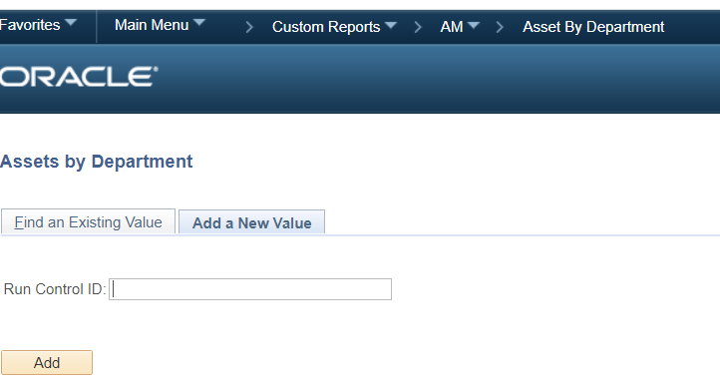
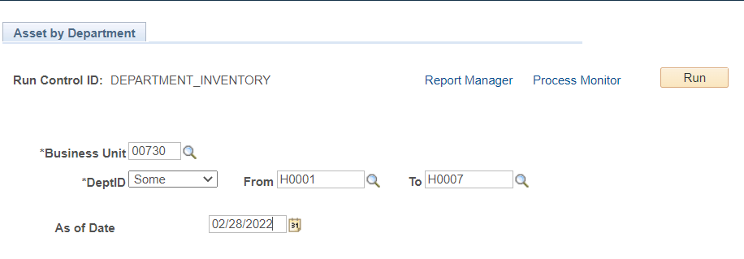
PeopleSoft Asset Management System (PSAM) – How to run Asset By Department Report
* You can RUN as PDF and/or CSV (Excel) files

Slide 14
Property Management Forms
Property Management forms listed were revised effective 9/1/2022
and are processed through DocuSign
Asset Update – PRP-1A
Authorization for Off-Campus Property
Off Campus Property Returned
Designation Property Custodian – PRP-6A
Certification of Departmental Physical Inventory
Forms are located on the Property Management website
https://uh.edu/office-of-finance/accounting-services/property-management/forms/

Slide 15

Property Management Contacts
Property Management Email: Propertyacctg@UH.EDU
Minhthu Pham – Property Manager
Phone: 713-743-8757
Email: Mpham@Central.UH.EDU
Victor Wongchukit – Assistant Property Manager
Phone: 713-743-8758
Email: Vwongchukit@Central.UH.EDU
Langston Royster – Accountant II
Phone: 713-743-8760
Email: LFRoyster@Central.UH.EDU
Raymon Matthews – Coordinator
Phone: 713-743-8759
Email: Rmatthews@Central.UH.EDU
Amy Hutchings – Accountant II
Phone: 713-743-7766
Email: ajhutch3@Central.UH.EDU.

Slide 16


Q & A

Slide 17
Property Management
Thank you !

