Slide 1

Masking Guidelines & Techniques
Training Module
University of Houston Education Research Center

Slide 2
Module Objectives
Upon completion of this training, UH ERC researchers should be able to:
  Describe FERPA as it relates to research conducted using the P-20/ Workforce Data Repository (Data Repository);
  Properly mask data to comply with federal and state regulations using the UH ERC’s Masking Guidelines & Techniques; and
  Submit masked data through the Review of Research Products Process

Slide 3
Module Topics
UH ERC and FERPA
Masking data
Masking exemplars
Review of research products process

Slide 4
UH ERC & FERPA
Overview of FERPA
  Key FERPA definitions
  Establishment of the UH ERC
  FERPA compliance

Slide 5
Family Educational Rights and Privacy Act of 1974
(20 U.S.C. 1232g: 34 C.F.R. 99)
Protects the privacy of educational records
  Explains what information is deemed personally identifiable information
  Establishes criteria for access
  Defines who shall be granted access

Slide 6
Key FERPA Definitions
Educational Record
Personally Identifiable Information (PII)
Any record that is directly related to a student and is maintained by an educational agency, institution, or by a party acting for the agency or institution
FERPA further provides exclusions under this
Information that can be used to distinguish an individual directly or indirectly through linkages with other information
Many of the direct PII, such as student name and Social Security Number are removed, yet PII remains rich in the Repository
Indirect PII is any information that can be linked to a specific student

Slide 7
Key FERPA Definitions
Indirect PII
“ Information that, alone or in combination, is linked or linkable to a specific student that would allow for a reasonable person in the school community, who does not have personal knowledge of the relevant circumstances, to identify the student with reasonable certainty” (National Center for Education Statistics, 2010, p. 2)

Slide 8
Education Research Centers
Texas Administrative Code (19 Tex. Admin. Code § 1.18)
  Collection and compilation of the P-20 Workforce Data Repository (Repository)
  Authorizes ERC Advisory Board to oversee Education Research Centers in Texas
  Provides guidelines for ERC operations
  The UH ERC is an authorized representative of the State of Texas, which makes the researcher an agent

Slide 9
UH ERC Mission
  To bridge the gap between theory and policy by providing a cooperative research environment for study by both scholars and policymakers

Slide 10
UH ERC and FERPA
FERPA provides information for
  Evaluation exceptions
  Study exemptions
FERPA Compliance Training covers
  Masking guidelines and techniques
  Review of research products process

Slide 11
Module Topics
UH ERC and FERPA
Masking data
Masking exemplars
Review of research products process

Slide 12
Masking Data
This training module provides information, guidelines, and techniques for masking data provided by:
  FERPA
  State of Texas
  UH ERC

Slide 13
Masking Definition
Masking
  Purposeful exclusion or removal of information prior to public release to protect individuals under FERPA
Masking is the purposeful exclusion or removal of information before public release to protect individuals under FERPA.
Common Definition of Masking

Slide 14
Important Guidelines
When assessing data for masking requirements, the following guidelines must be considered:
FERPA
  Can a reasonable person in the school community use the information presented, alone or in combination with other publicly available information, to identify an individual?
State of Texas
  “…P-20/Workforce Data Repository provided to an ERC includes all individual-level data, including any data cells small enough to allow identification of an individual. All data cells containing between one and four individuals, inclusive, are confidential”(19 Tex. Admin. Code § 1.18)

Slide 15
Required Masking
Small Cell Masking
Top and Bottom Coding
Complementary Cell Suppression

Slide 16
Small Cell Masking
General rule: Fewer than 5 per cell must be masked
 | Solution
Condition | Numerator | Denominator | Percent
If denominator is <5 including 0 | Mask (*) | Mask (*) | Mask (*)
If percent is 100% or rounds to 100% | Mask (*) | Mask (*) | Top Code %
If percent is 0% or rounds to 0% | Mask (*) | Mask (*) | Bottom Code %
If the difference between the numerator and the denominator is fewer than 3 | Mask (*) | Mask (*) | %
If the numerator is <5 including 0 | Mask (*) | Mask (*) | %

Slide 17
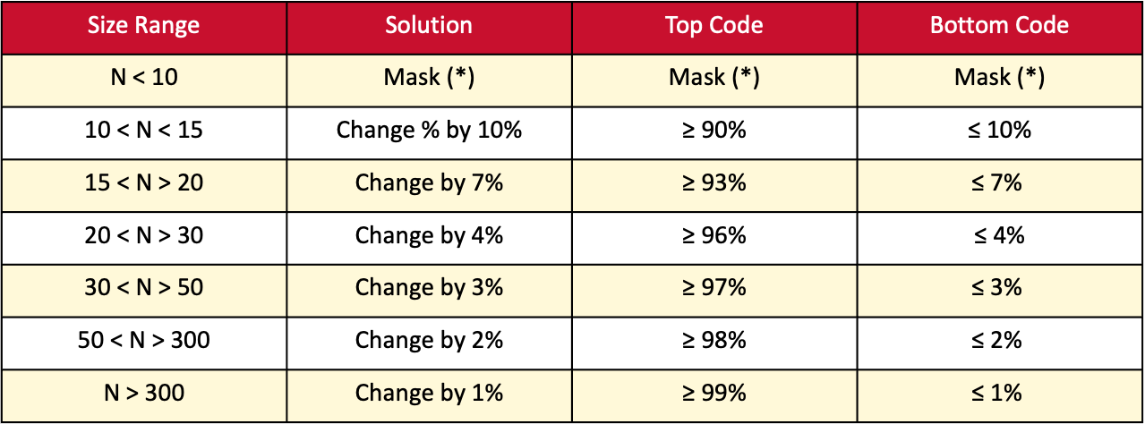
Top and Bottom Coding
General rule: If the percentage is or rounds to 100%, you must top and bottom code
Size Range | Solution | Top Code | Bottom Code
N < 10 | Mask (*) | Mask (*) | Mask (*)
10 < N < 15 | Change % by 10% | ≥ 90% | ≤ 10%
15 < N > 20 | Change by 7% | ≥ 93% | $$\text{≤ 7\%}$$
20 < N > 30 | Change by 4% | ≥ 96% | ≤ 4%
30 < N > 50 | Change by 3% | ≥ 97% | $$\text{≤ 3\%}$$
50 < N > 300 | Change by 2% | ≥ 98% | $$\text{≤ 2\%}$$
N > 300 | Change by 1% | ≥ 99% | $$\text{≤ 1\%}$$

Slide 18
Complementary Cell Suppression
General rule: If, through reverse calculations, a reasonable person can recover masked cell information, then the next associated smallest cell must be masked
Complementary cell suppression is not necessary in all situations, but it is mandatory when it applies

Slide 19
Masking Guidelines Review
Small Cell Masking- cell values less than 5 must be masked
Top & Bottom Coding- If the percentage is or rounds to 0 or 100%, you must top and bottom code
Complementary Cell Suppression - If, through reverse calculations, a reasonable person can recover masked cell information, the next associated smallest cell must be masked

Slide 20
Module Topics
UH ERC and FERPA
Masking data
Masking Exemplars
Review of research products process

Slide 21
Masking Exemplars
Masking exemplars included in this section are:
  Small Cell Masking
  Complementary Cell Suppression
  Top and Bottom Coding
  Collapsing Categories
  Secondary Publications

Slide 22
Small Cell Masking
Appleseed Elementary School, STAAR Reading
by Performance Standards, 2019, Grade 5
 | Totals | Approaches Grade Level | Meets Grade Level | Masters Grade Level
All Students | 290 | 75 | 174 | 41
Gifted & Talented | 28 | 0 | 8 | 20
Special Education | 25 | 13 | 12 | 0
Economically Disadvantaged | 272 | 71 | 165 | 36
English Language Learner | 90 | 53 | 35 | 2

Slide 23
Small Cell Masking
General Rule: You must mask if
  The denominator is less that 5, including 0
  If the difference between the numerator and denominator is fewer than 3
  If the numerator is less than 5, including 0

Slide 24
Small Cell Masking
Appleseed Elementary School, STAAR Reading
by Performance Standards, 2019, Grade 5
 | Totals | Approaches Grade Level | Meets Grade Level | Masters Grade Level
All Students | 290 | 75 | 174 | 41
Gifted & Talented | 28 | 0 | 8 | 20
Special Education | 25 | 13 | 12 | 0
Economically Disadvantaged | 272 | 71 | 165 | 36
English Language Learner | 90 | 53 | 35 | 2
*
*
*

Slide 25
Complementary Cell Suppression
Appleseed Elementary School, STAAR Reading
by Performance Standards, 2019, Grade 5
 | Totals | Approaches Grade Level | Meets Grade Level | Masters Grade Level
All Students | 290 | 75 | 174 | 41
Gifted & Talented | 28 | * | 8 | 20
Special Education | 25 | 13 | 12 | *
Economically Disadvantaged | 272 | 71 | 165 | 36
English Language Learner | 90 | 53 | 35 | *
*
*
*

Slide 26
Top and Bottom Coding
General Rule: If the percent is or rounds to 0 or 100%, you must top and bottom code
Size Range | Solution | Top Code | Bottom Code
N < 10 | Mask (*) | Mask (*) | Mask (*)
10 < N < 15 | Change percent by 10% | ≥ 90% | ≤ 10%
15 < N > 20 | Change by 7% | ≥ 93% | ≤ 7%
20 < N > 30 | Change by 4% | ≥ 96% | ≤ 4%
30 < N > 50 | Change by 3% | ≥ 97% | ≤ 3%
50 < N > 300 | Change by 2% | ≥ 98% | ≤ 2%
N > 300 | Change by 1 % | ≥ 99% | ≤ 1%

Slide 27
Top and Bottom Coding
Appleseed Elementary School, STAAR Reading
by Performance Standards, 2019, Grade 5
 | Approaches Grade Level | Meets Grade Level | Masters Grade Level
Gifted & Talented | 0.0% | 28.5% | 71.4%
Special Education | 52.0% | 48.0% | 0.0%
Economically Disadvantaged | 26.1% | 60.7% | 13.2%
English Language Learner | 58.9% | 38.8% | 2%
Based on guidelines, N=290, top & bottom code adjustments by 2%.

Slide 28
Top and Bottom Coding
Appleseed Elementary School, STAAR Reading
by Performance Standards, 2019, Grade 5
 | Approaches Grade Level | Meets Grade Level | Masters Grade Level
Gifted & Talented | ≤ 2% | 29% | 71%
Special Education | 52% | 48% | ≤ 2%
Economically Disadvantaged | 26% | 61% | 13%
English Language Learner | 59% | 39% | 28
Observe the change in coding – 0% entries are changed to ≤ 2%
Note: There are remaining FERPA compliance issues with this exemplar table. Researchers would need to consider the collapsing of categories to mitigate issues with the unmaking of bottom-coded information.

Slide 29
Secondary Publications
Appleseed Elementary School, STAAR Reading
by Performance Standards, 2019, Grade 5
 | Approaches Grade Level | Meets Grade Level | Masters Grade Level
Gifted & Talented | ≤2% | 29% | 71%
Special Education | 52% | 48% | ≤2%
Economically Disadvantaged | 26% | 60% | 13%
English Language Learner | 59% | 39% | 2%

Slide 30
Collapsing Categories
Appleseed Elementary School, STAAR Reading by Performance Standards, 2019, Grade 5
 | Totals | Approaches Grade Level | Meets & Masters Grade Level
All Students | 290 | 75 | 215
Gifted & Talented | 28 | * | *
Special Education | 25 | 13 | 12
Economically Disadvantaged | 272 | 71 | 201
English Language Learner | 90 | 53 | 37

Slide 31
Resource
  The Policies & Procedures: Approved Project Handbook includes masking guidelines and techniques for easy reference
  The handbook is located on the UH ERC website

Slide 32
Module Topics
UH ERC and FERPA
Masking data
Masking Exemplars
Review of research products process

Slide 33
Review of Research Products Process
This portion of the training module covers:
  An overview of the research products review process
  A sample request for review
  Commonly used variables
  Common issues
  Key reminders

Slide 34
Research Product Definition
Research Product
Any written outcome or display derived from the Repository
Research output such as log files, statistical output, tables, or graphs
Any article that is intended to, or potentially could be viewed by anyone not currently approved to use the Repository

Slide 35
Research Review Process
Step 1– Researcher(s) reviews and applies Masking Guidelines & Techniques to research products
Step 4–UH ERC designee reviews file(s) to ensure FERPA compliance and appropriate masking techniques were applied
Step 5– Release of research product to researcher(s) by direct transmission by email or another means, as appropriate.
Is the research product consistent with the researcher(s) certification of FERPA compliance and following Texas ERC Masking Guidelines?
Step 2– Researcher(s) create a “For FERPA Review” subfolder within project folder and copy files for review to it
Reviews typically take seven working days, unless review includes several research products for review
If researcher(s) requires more immediate action, please contact the Director or authorized designee to see if arrangements can be made
Each items requested for review is recorded in the Released Item Review Log
Preferred format Microsoft Excel
All variables clearly labeled and described
Output clearly labeled
No
Yes
Reviewer does not have sufficient information or has reason to suspect the research is not consistent with certification of FERPA compliance.
Step 3– Researcher(s) make a formal request for review to the Director or authorized designee
Step 6–After the research product is released, researcher deletes the released products from the “For FERPA review” folder
Send email following the request for review example on the “Request for Review” example and template slides
Reviewer may request additional evidence and/or justification such as log files, intermediate data sets, cell size counts
Reviewer may request modification of the research product
Reviewer refuses release of the research product
Researcher(s) may appeal reviewer’s decision to the Director and ultimately, one of the CO-PI’s of the UH ERC. A formal appeal must be received in writing. Appeals will run through the established review protocol.
Did the researcher(s) complete the request from the reviewer?
Yes
No

Slide 36
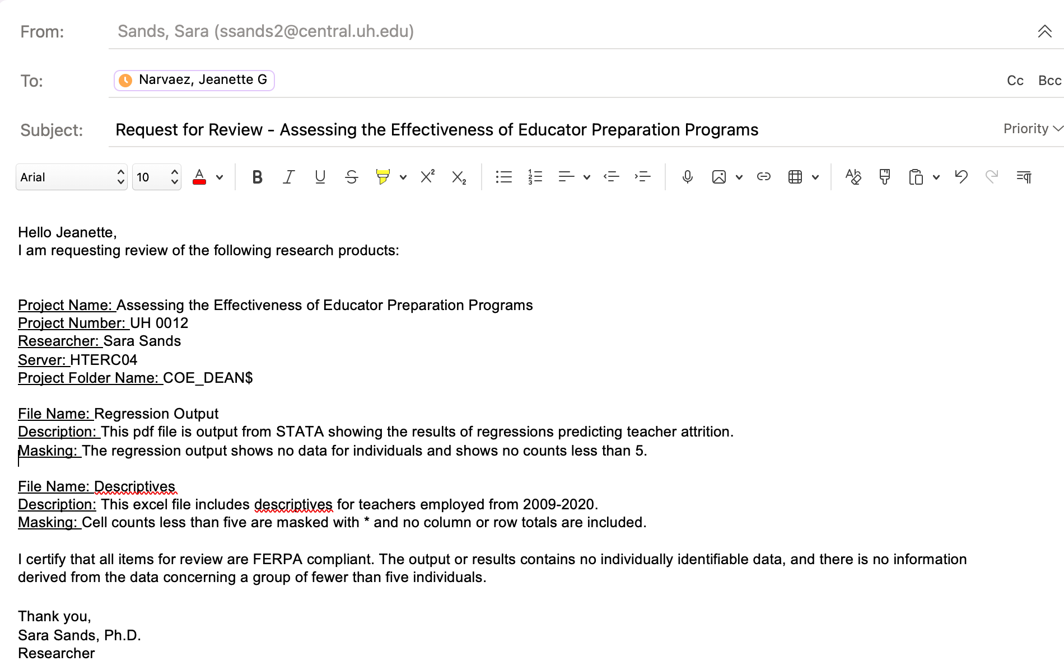
Request for Review Example
jgnarvae@central.uh.edu

Slide 37
Research Review Email Template
Hello,
I am requesting review of the following research products:
Project Name:
Project Number:
Researcher:
Server:
Project Folder Name:
File Name:
Description:
Masking:
I certify that all items for review are FERPA compliant. The output or results contains no individually identifiable data, and there is no information derived from the data concerning a group of fewer than five individuals.

Slide 38
Commonly Used Variables
Performance based indicators
  STAAR, TAKS, SAT/ACT scores, Texas Success Initiative (TSI), exit exams, cumulative pass rates, college readiness
  Individual scores cannot be released from the UH ERC
Program Participation
  Special education, gifted and talented, English Language Learner (ELL)/Limited English Proficiency (LEP), International Baccalaureate (IB), Developmental Education/Disability Services, Advanced Placement (AP) enrollment, college/dual credit scores

Slide 39
Commonly Used Variables
Student demographics
  Race/ ethnicity, age, and gender
  At-risk of dropping out, homelessness, foster care
Completion
  Dropout , graduation, time to completion, high school degree plan
Other
  Attendance, school transfers, teacher value-added scores

Slide 40
Common Issues
Unclear Variables or Outputs
  Clear labels
  Definitions
  Define and describe derived variables
Graphics
  Same masking guidelines apply to graphics
Degree of Detail
  Present most aggregated data possible

Slide 41
Review of Research Products Review
Follow the Masking Guidelines and Techniques for proper and required masking
Be mindful of commonly used variables and issues that could delay your review
Make sure to include all the necessary information in your formal request to avoid delays in the review process by using the template provided in this training
Keep in mind the average time needed to complete the research product review process is seven business days
Consult the Policies and Procedures for Approved Projects Handbook on the UH ERC website.

Slide 42
Training Complete
You are now ready to complete the Masking Guidelines and Techniques Training Assessment provided by the University of Houston ERC
Complete the assessment here .

